Slide 1
Interrupts

Slide 2
What Are Interrupts?
Interrupts alter a program’s flow of control
  Behavior is similar to a procedure call
    Some significant differences between the two
Interrupt causes transfer of control to an interrupt service routine (ISR)
    ISR is also called a handler
When the ISR is completed, the original program resumes execution
Interrupts provide an efficient way to handle unanticipated events

Slide 3
Interrupts versus Procedures
Interrupts
Initiated by both software and hardware
Can handle anticipated and unanticipated internal as well as external events
ISRs or interrupt handlers are memory resident
Use numbers to identify an interrupt service
(E)FLAGS register is saved automatically
Procedures
Can only be initiated by software
Can handle anticipated events that are coded into the program
Typically loaded along with the program
Use meaningful names to indicate their function
Do not save the (E)FLAGS register

Slide 4
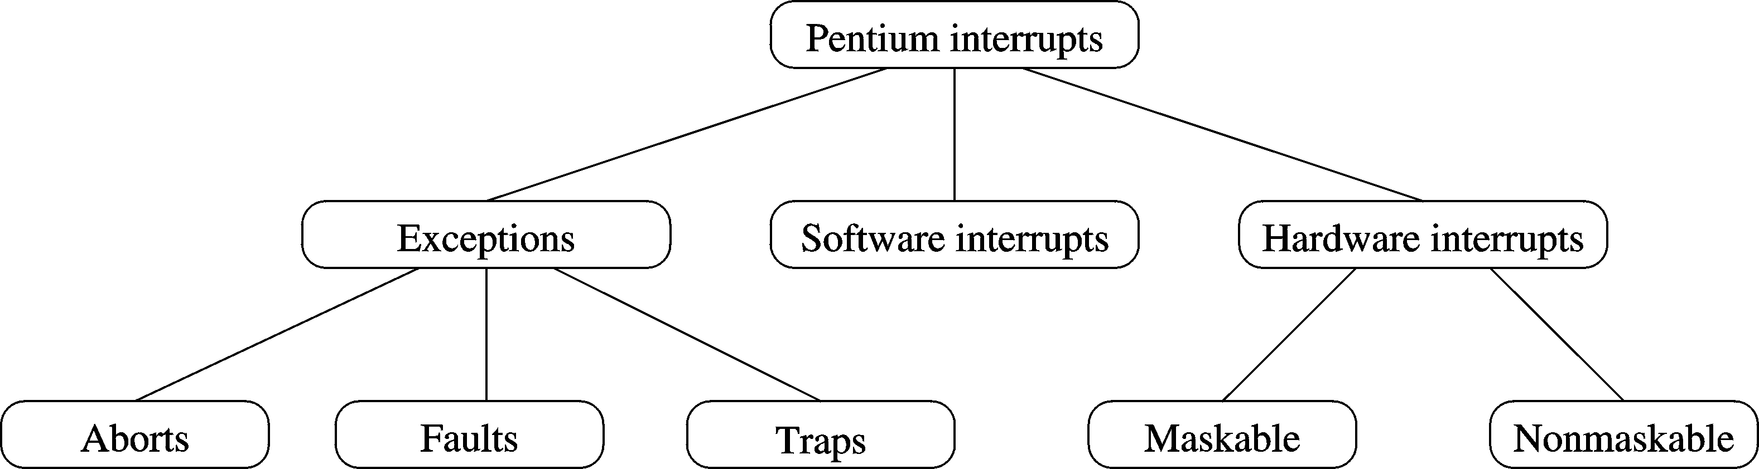
A Taxonomy of Pentium Interrupts

Slide 5
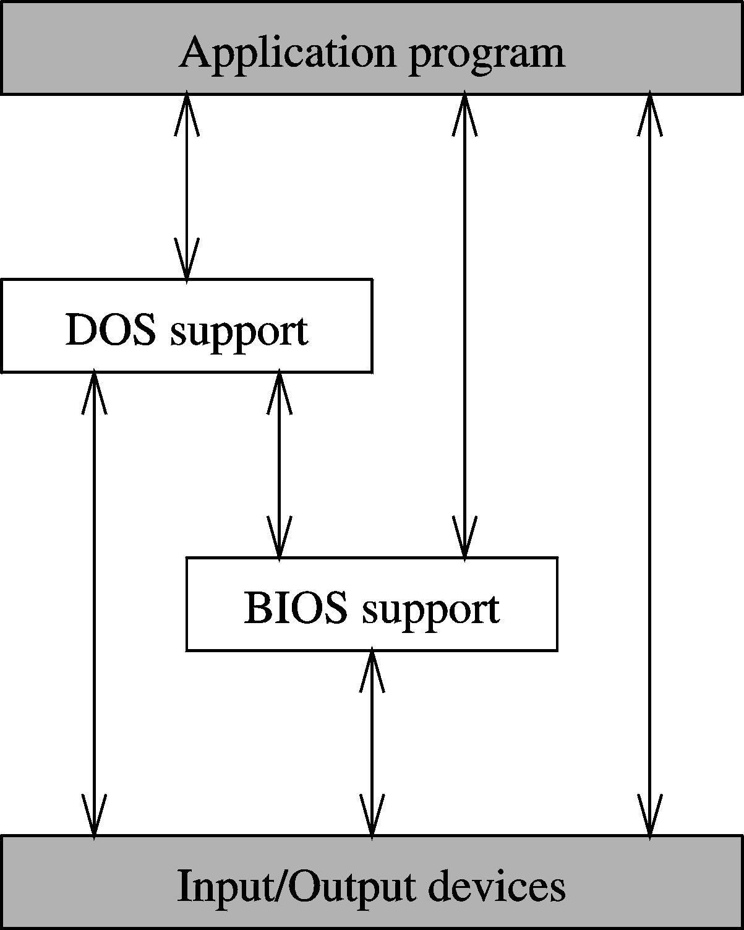
Various Ways of Interacting with I/O Devices

Slide 6
Interrupt Processing in Real Mode
Uses an interrupt vector table that stores pointers to the associated interrupt handlers.
  This table is located at base address zero.
Each entry in this table consists of a CS:IP pointer to the associated ISRs
  Each entry or vector requires four bytes:
    Two bytes for specifying CS
    Two bytes for the offset
Up to 256 interrupts are supported (0 to 255).

Slide 7
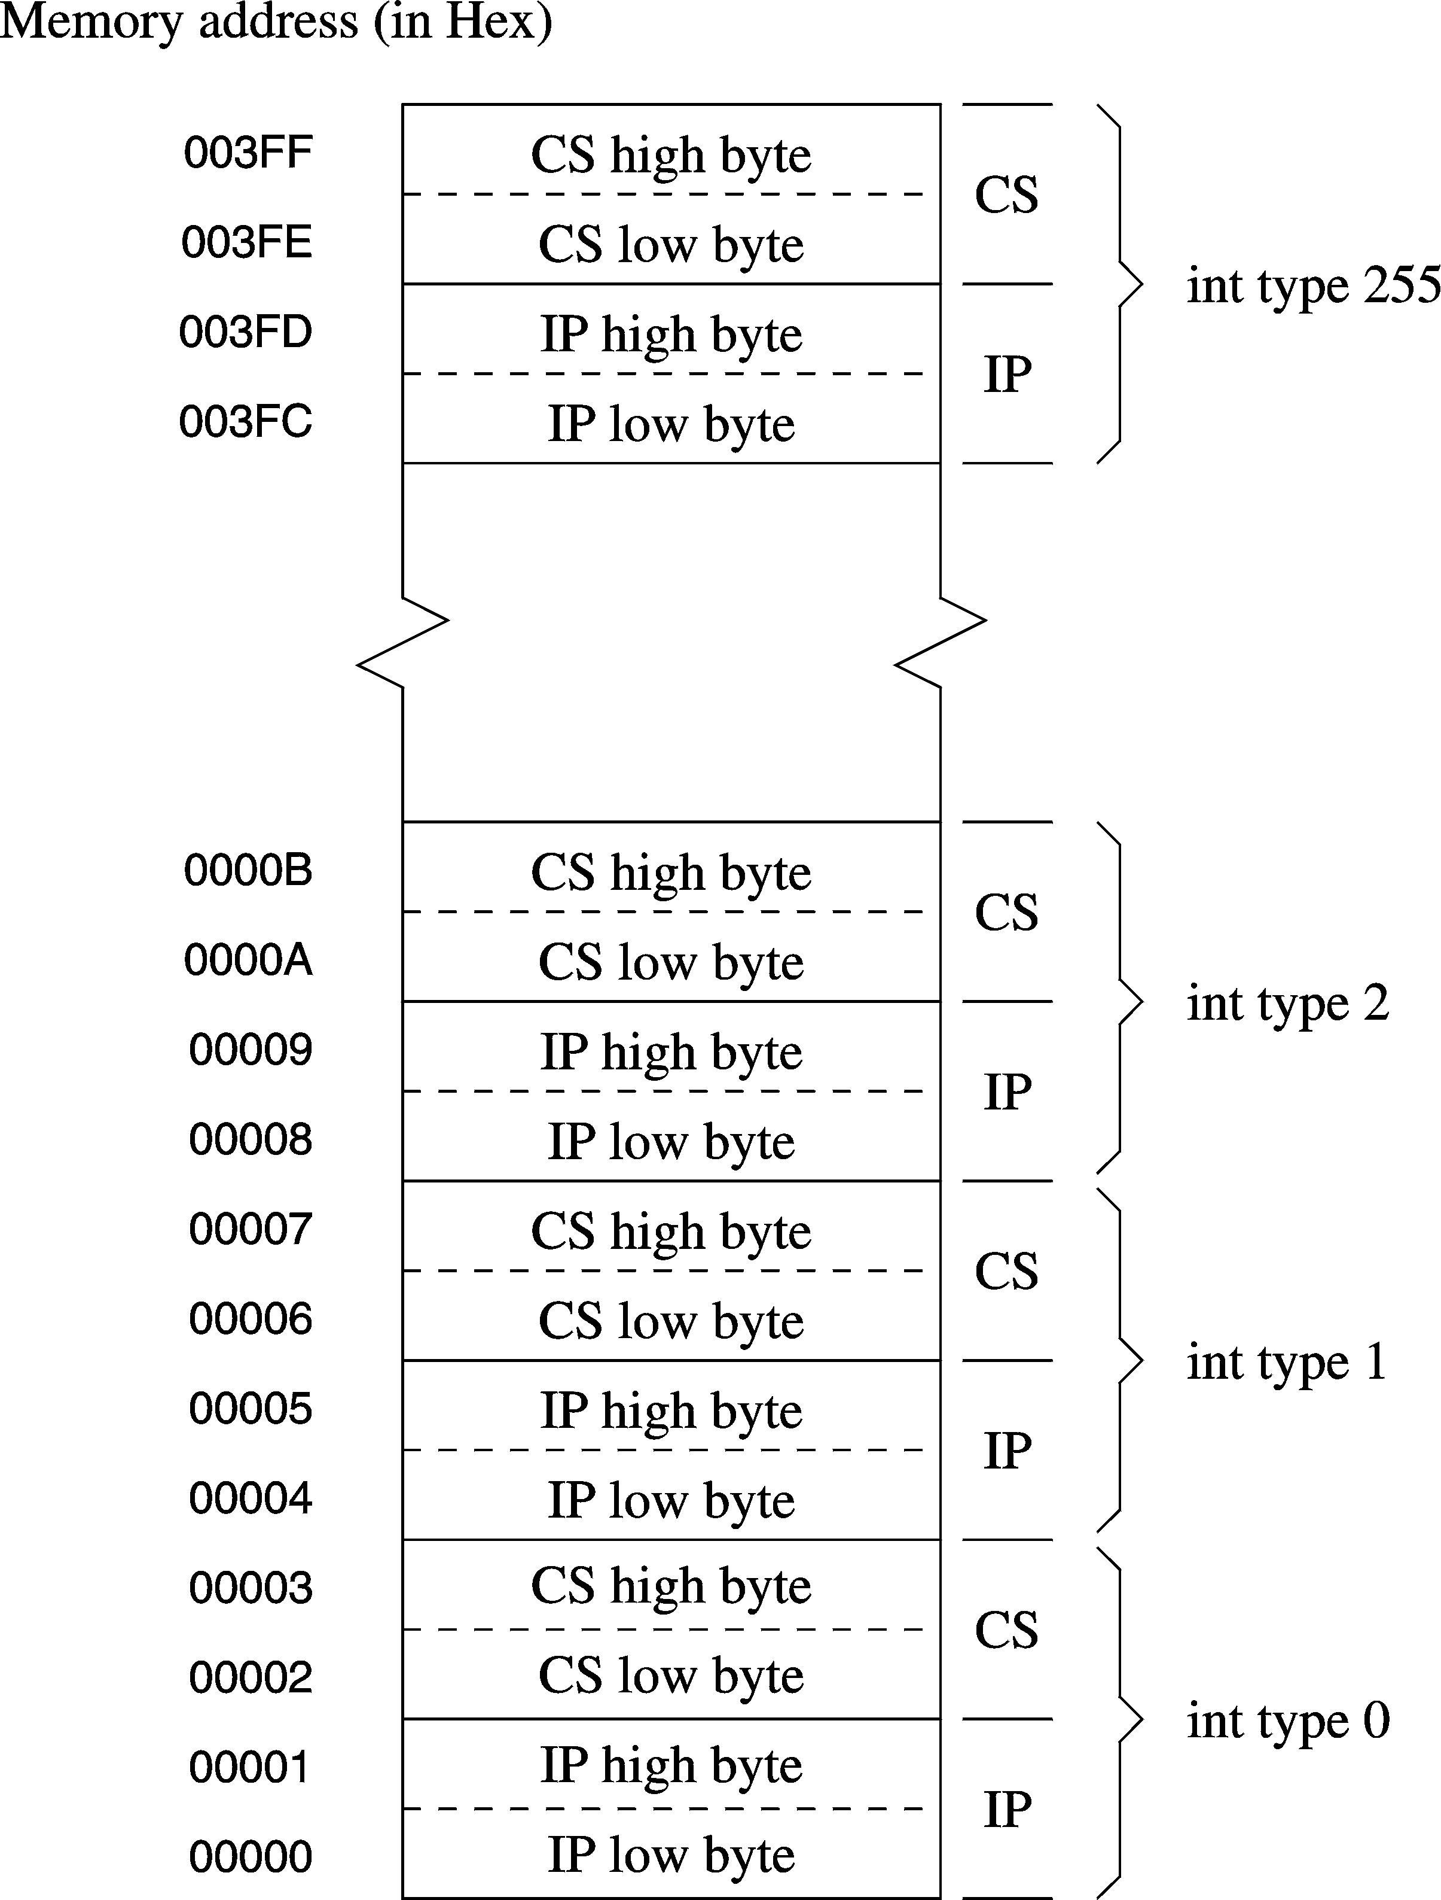
Interrupt Vector Table

Slide 8
Interrupt Number to Vector Translation
Interrupt numbers range from 0 to 255
Interrupt number acts as an index into the interrupt vector table
Since each vector takes 4 bytes, interrupt number is multiplied by 4 to get the corresponding ISR pointer
Example
For interrupt 2, the memory address is
2 ∗ 4 = 8H
The first two bytes at 8H are taken as the offset value
The next two bytes (i.e., at address AH) are used as the CS value

Slide 9
A Typical ISR Structure
Just like procedures, ISRs should end with a return statement to return control back
The interrupt return (iret) is used of this purpose
  ;save the registers used in the ISR
  sti ;enable further interrupts
  . . .
  ISR body
  . . .
  ;restore the saved registers
  iret ;return to interrupted program

Slide 10
What Happens When An Interrupt Occurs?
Push flags register onto the stack
Clear interrupt enable and trap flags
  This disables further interrupts
  Use sti to enable interrupts
Push CS and IP registers onto the stack
Load CS with the 16-bit data at memory address
    interrupt-type ∗ 4 + 2
Load IP with the 16-bit data at memory address
    interrupt-type ∗ 4

Slide 11
Interrupt Enable Flag Instructions
Interrupt enable flag controls whether the processor should be interrupted or not
Clearing this flag disables all further interrupts until it is set
  Use cli (clear interrupt) instruction for this purpose
  It is cleared as part interrupt processing
Unless there is special reason to block further interrupts, enable interrupts in your ISR
  Use sti (set interrupt) instruction for this purpose

Slide 12
Returning From An ISR
As in procedures, the last instruction in an ISR should be iret
The actions taken on iret are:
  pop the 16-bit value on top of the stack into IP register
  pop the 16-bit value on top of the stack into CS register
  pop the 16-bit value on top of the stack into the flags register
As in procedures, make sure that your ISR does not leave any data on the stack
  Match your push and pop operations within the ISR

Slide 13
Dedicated Interrupts
Several Pentium predefined interrupts --- called dedicated interrupts
These include the first five interrupts:
  interrupt type Purpose
  0 Divide error
  1 Single-step
  2 Nonmaskable interrupt (MNI)
  3 Breakpoint
  4 Overflow

Slide 14
Dedicated Interrupts (cont’d)
Divide Error Interrupt
  CPU generates a type 0 interrupt whenever the div/idiv instructions result in a quotient that is larger than the destination specified
Single-Step Interrupt
  Useful in debugging
  To single step, Trap Flag (TF) should be set
  CPU automatically generates a type 1 interrupt after executing each instruction if TF is set
  Type 1 ISR can be used to present the system state to the user

Slide 15
Dedicated Interrupts (cont’d)
Breakpoint Interrupt
  Useful in debugging
  CPU generates a type 3 interrupt
  Generated by executing a special single-byte version of int 3 instruction (opcode CCH)
Overflow Interrupt
  Two ways of generating this type 4 interrupt
    int 4 (unconditionally generates a type 4 interrupt)
    into (interrupt is generated only if the overflow flag is set)
  We do not normally use into as we can use jo/jno conditional jumps to take care of overflow

Slide 16
A Single-Step Interrupt Example
Objectives:
  To demonstrate how ISRs can be defined and installed (i.e., user defined ISRs)
  How trap flag can be manipulated
    There are no instruction to set/clear the trap flag unlike the interrupt enable flag sti/cli
We write our own type 1 ISR that displays the contents of AX and BX registers after each instruction has been executed

Slide 17
Hardware Interrupts
Software interrupts are synchronous events
  Caused by executing the int instruction
Hardware interrupts are of hardware origin and asynchronous in nature
  Typically caused by applying an electrical signal to the processor chip
Hardware interrupts can be
  Maskable
  Non-maskable
    Causes a type 2 interrupt

Slide 18
How Are Hardware Interrupts Triggered?
Non-maskable interrupt is triggered by applying an electrical signal to the MNI pin of Pentium
  Processor always responds to this signal
  Cannot be disabled under program control
Maskable interrupt is triggered by applying an electrical signal to the INTR (INTerrupt Request) pin of Pentium
  Pentium recognizes this interrupt only if IF (interrupt enable flag) is set
  Interrupts can be masked or disabled by clearing IF

Slide 19
How Does the CPU Know the Interrupt Type?
Interrupt invocation process is common to all interrupts
  Whether originated in software or hardware
For hardware interrupts, CPU initiates an interrupt acknowledge sequence
  CPU sends out interrupt acknowledge (INTA) signal
  In response, interrupting device places interrupt type number on the data bus
  CPU uses this number to invoke the ISR that should service the device (as in software interrupts)

Slide 20
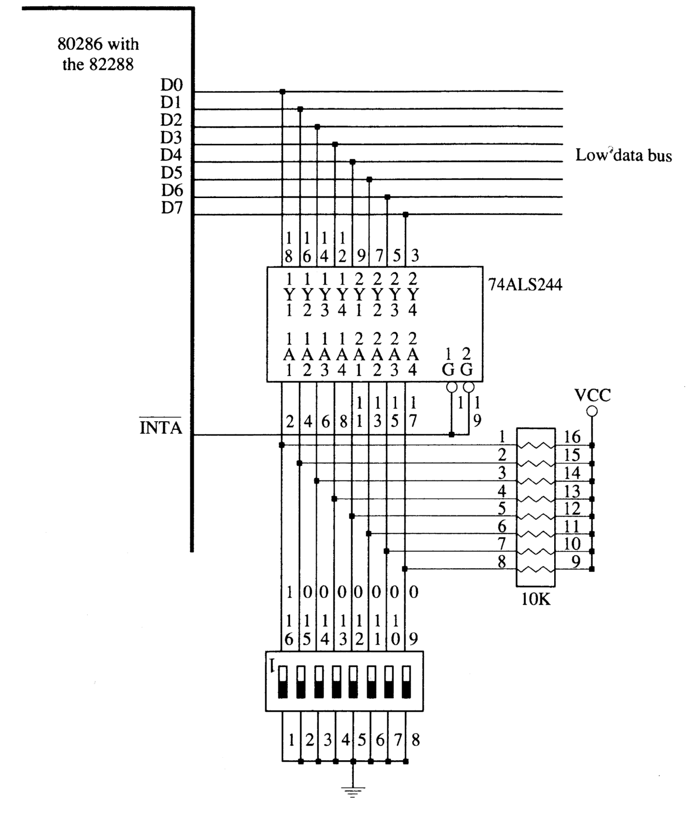

Slide 21
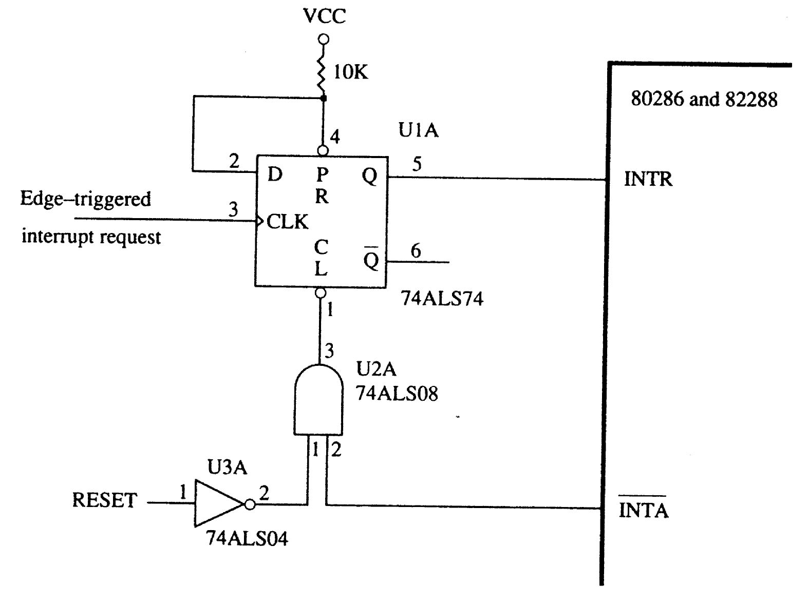

Slide 22
How can More Than One Device Interrupt?
Processor has only one INTR pin to receive interrupt signal
Typical system has more than one device that can interrupt --- keyboard, hard disk, floppy, etc.
Use a special chip to prioritize the interrupts and forward only one interrupt to the CPU
8259 Programmable Interrupt Controller chip performs this function (more details later)

Slide 23
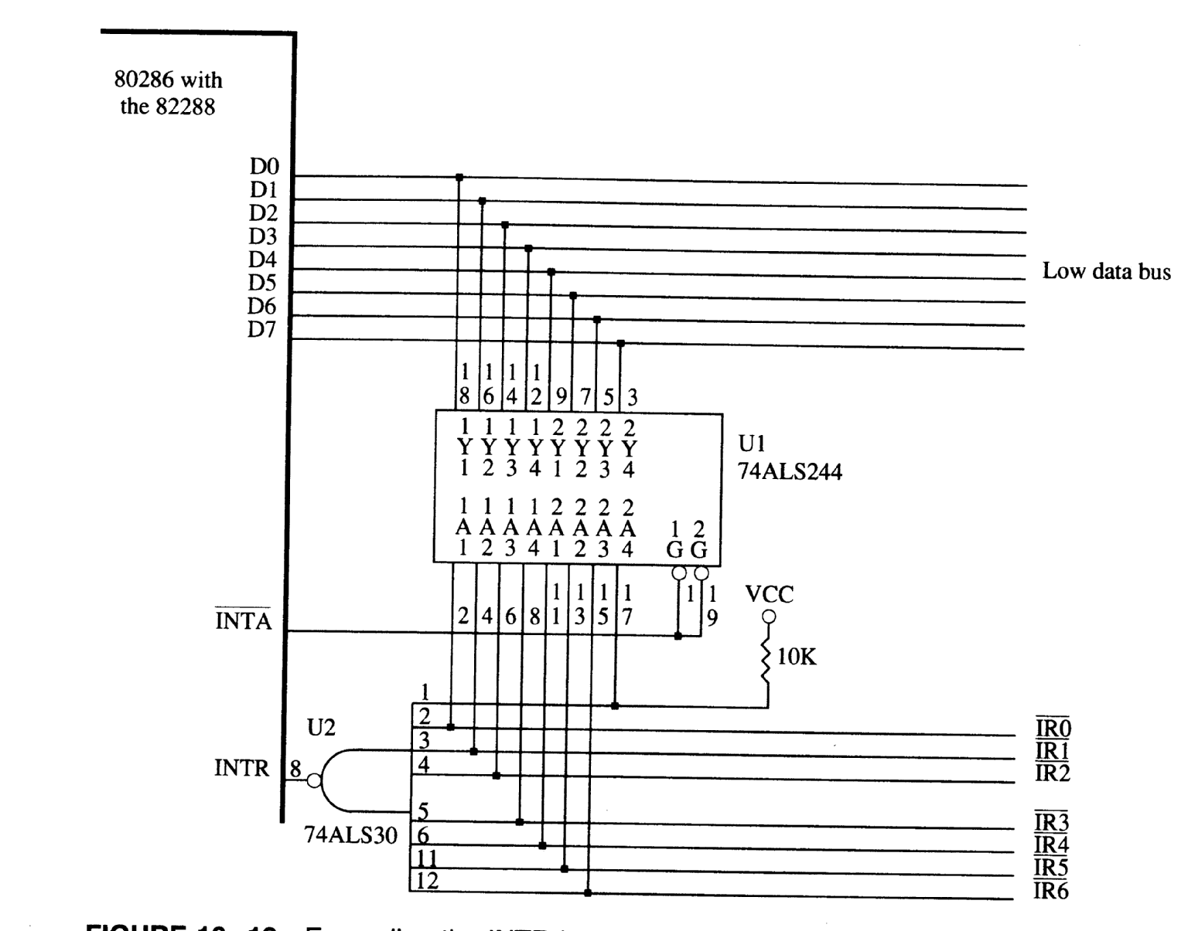
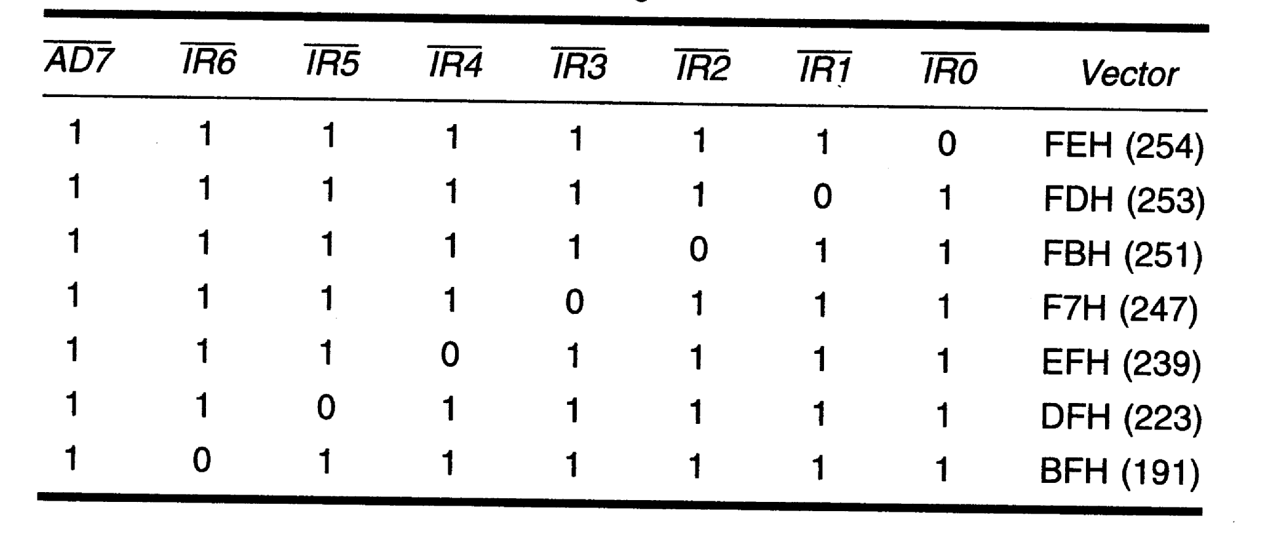

Slide 24
8259 Programmable Interrupt Controller
8259 can service up to eight hardware devices
  Interrupts are received on IRQ0 through IRQ7
8259 can be programmed to assign priorities in several ways
  Fixed priority scheme is used in the PC
    IRQ0 has the highest priority and IRQ7 lowest
8259 has two registers
  Interrupt Command Register (ICR)
    Used to program 8259
  Interrupt Mask Register (IMR)

Slide 25
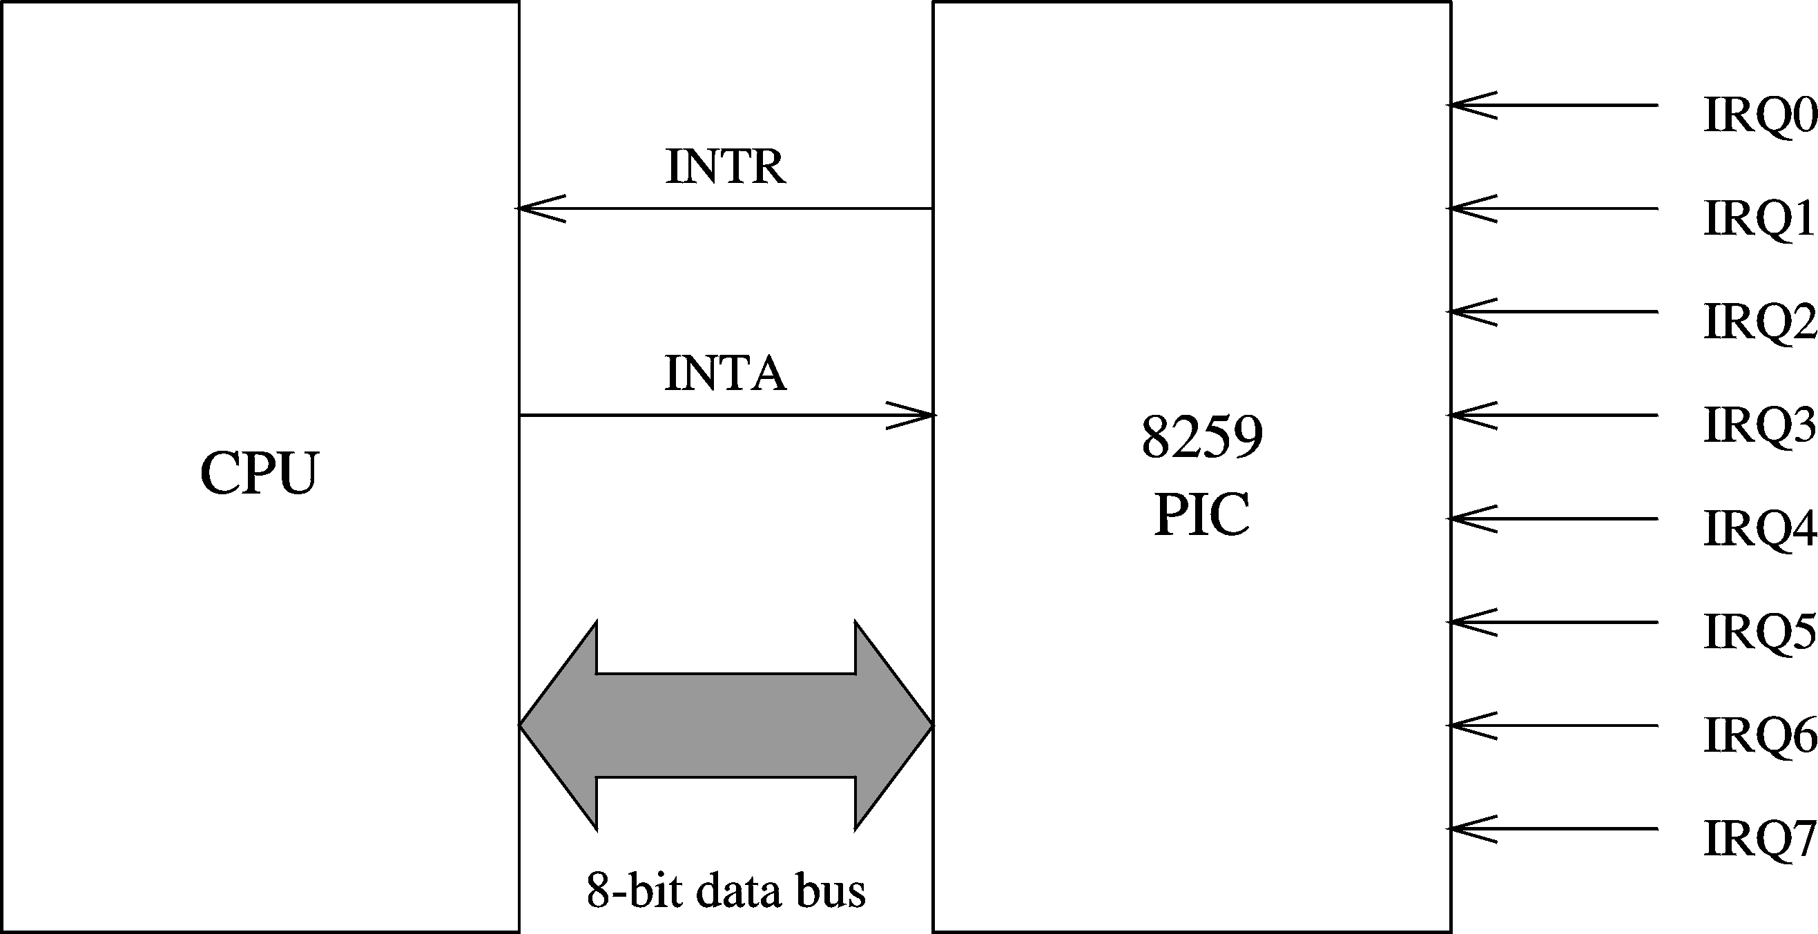
8259 PIC (cont’d)

Slide 26
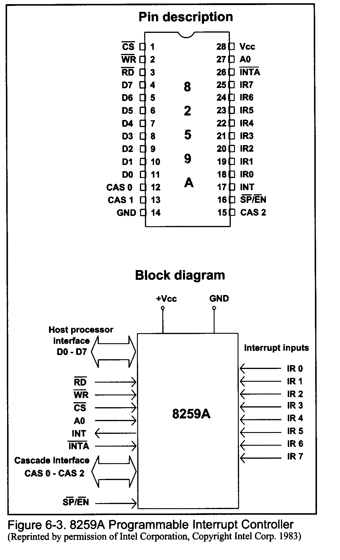
8259 Programmable Interrupt Controller

Slide 27
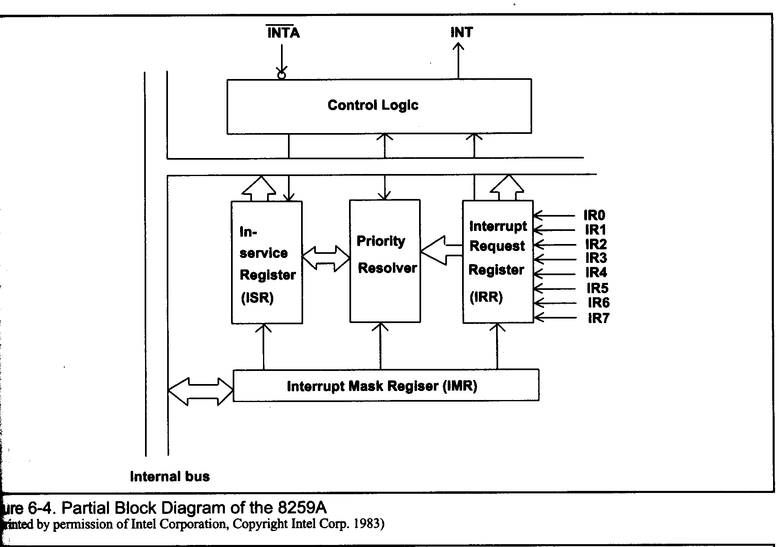
8259 Programmable Interrupt Controller Block Diagram

